Slide 1

BOOST::BEAST
REST API
USING IN C++

Slide 2
Something about BOOST::BEAST
FOR WHAT? JG REBOOT
ASIO
BEAST
Linking BEAST WITH ASIO
BEAST BENCHMARK AGAINST OTHER LIBS
HTTP Protocols
REST
REST API
RESTFul API
HTTP PROTOCOLS EXAMPLE
REST API EXAMPLE
RESTFUL API EXAMPLE
CONCLUSION
REFERENCES

Slide 3

Something about BOOST::BEAST
What you need to know to understand boost::beast:
Layered Network Model (ISO/OSI)
ASIO
Network Protocols

Slide 4
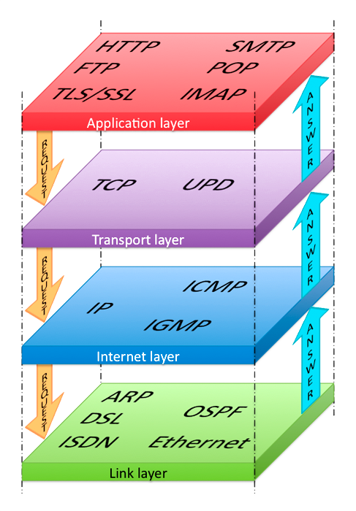
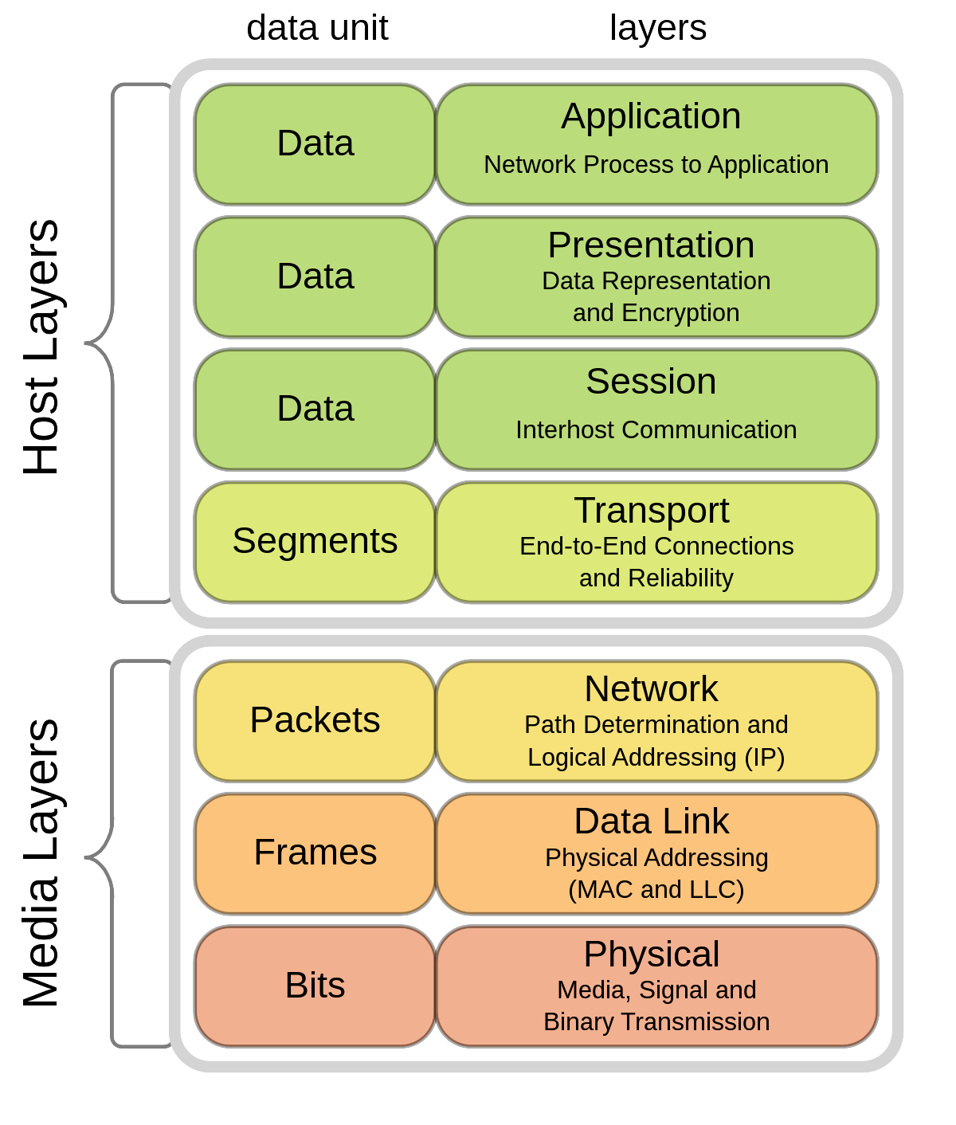
Something about BOOST::BEAST
The Internet Protocol Stack Model
Layered Network Model (ISO/OSI)

Slide 5
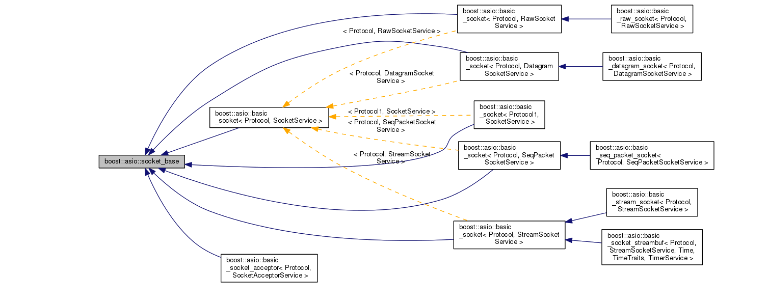
Something about BOOST::BEAST
ASIO Model

Slide 6

FOR WHAT?

Slide 7

JG REBOOT

Slide 8

ASIO
Asynchronous programming model
Multi-threading support
Support of various protocols
Cross-platform
Ease of use
Wide user community

Slide 9
ASIO
The main components of asio are:
io_context is a class that manages asynchronous I/O operations. It provides a mechanism for queuing tasks and executing them asynchronously.
ip::tcp::socket is a class that represents a TCP socket. It is used to establish a connection with a remote host and exchange data.
ip::tcp::acceptor is a class that is used to listen for incoming connections on the server.
ip::udp::socket is a class that represents a UDP socket. It is used to send and receive datagrams.
ssl::stream is a class that represents a secure SSL connection. It is used to establish a secure connection and exchange data with a remote host.
https://github.com/memorisecodead/BeastExample/blob/main/Examples/ASIO/ASIOExample.hpp

Slide 10
BEAST
Ease of use
High performance
Multithreading support
Multi-protocol support
Cross-platform
Extensibility
Beast supports the following versions of the HTTP protocol:
HTTP/1.0
HTTP/1.1
HTTP/2

Slide 11
BEAST
Boost.Beast provides many methods and classes for working with network protocols in C++. Some of the most commonly used methods in Boost.Beast are:
http::request and http::response: classes for representing HTTP requests and responses, respectively.
http::write and http::read: functions for writing and reading HTTP requests and responses respectively.
http::async_write and http::async_read: asynchronous analogues of http::write and http::read.
websocket::stream: class for working with WebSocket protocol.
websocket::async_write and websocket::async_read: asynchronous methods for sending and reading messages through the WebSocket protocol.
ssl::context: class for configuring SSL/TLS connections.
ssl::stream: class for working with secured SSL/TLS connections.
tcp::socket: class for working with TCP sockets.
tcp::acceptor: class for listening for incoming connections on TCP socket.
streambuf: a class for buffering data input/output.
This is just a small list of methods and classes provided by Boost.Beast. The library also provides many other components that can be used for networking protocols in C++.
https://github.com/memorisecodead/BeastExample/tree/main/Examples/HTTPServer

Slide 12

Linking BEAST WITH ASIO
Beast at its core uses Asio to implement the asynchronous I/O needed to handle HTTP and WebSocket protocols. Asio provides mechanisms for asynchronous data reading and writing as well as for managing network connections.
Thanks to asio, it is possible to use SSL to make a secure HTTPS request.
Thus, Beast and Asio are closely related: Beast uses Asio to implement asynchronous I/O, and Asio provides the necessary functions and classes to handle asynchronous I/O in Beast. Using Asio allows Beast to provide high performance and efficiency with HTTP and WebSocket protocols.

Slide 13
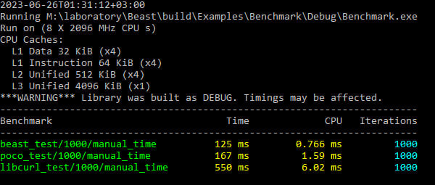
BEAST BENCHMARK AGAINST OTHER LIBS
For this benchmark, the following test code was written, which performs 1000 HTTP GET requests to Google and measures the average execution time of the request and the number of requests per second:
The benchmark was run on a machine with AMD Ryzen 5 3550h processor and Windows 22H2 operating system. The code was compiled with MSVC 14.32.31326.
Below are benchmark results comparing Beast, Poco, and Libcurl libraries for HTTP queries:
Lib versions:
boost/1.81.0 (beast/1.82.0)
poco/1.12.4
libcurl/8.1.2
https://github.com/memorisecodead/BeastExample/blob/main/Examples/Benchmark/main.cpp

Slide 14
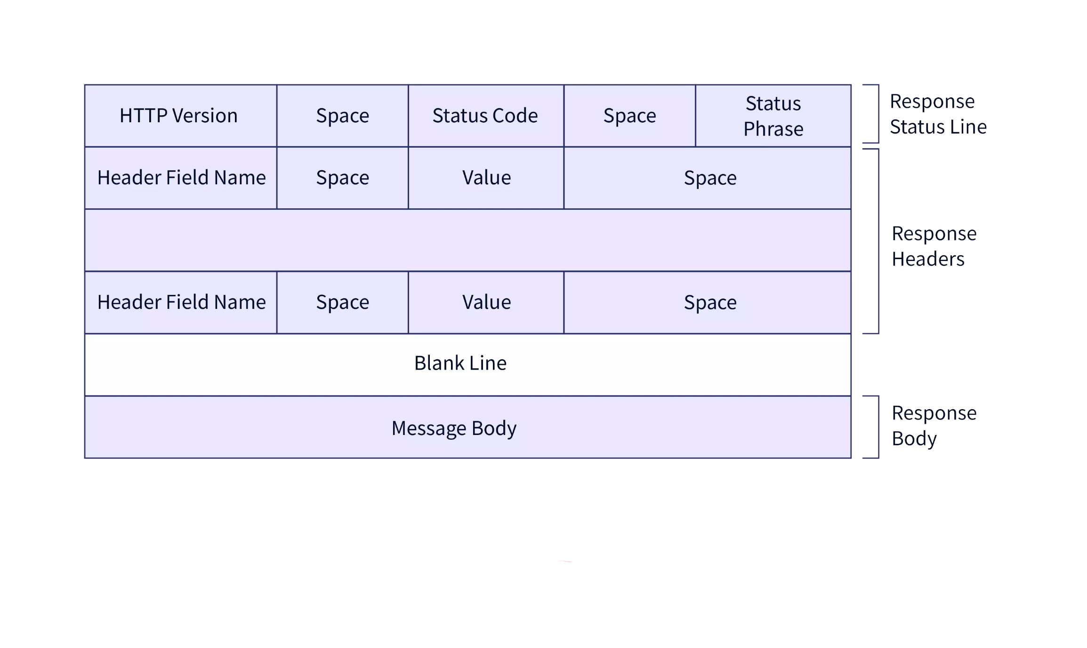
HTTP PROTOCOLS
HyperText Transfer Protocol is an application layer protocol used to
transfer data between a client and a server on the Internet.
There are several versions of the HTTP protocol:
HTTP/0.9
HTTP/1.0
HTTP/1.1
HTTP/2
HTTP/3
HTTP Construction

Slide 15
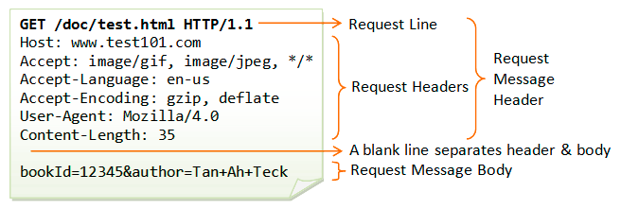
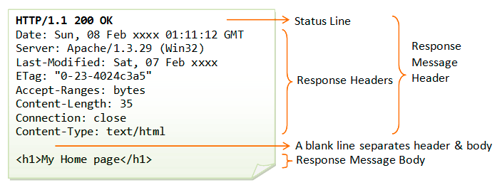
HTTP PROTOCOLS
HTTP Request
HTTP Response

Slide 16
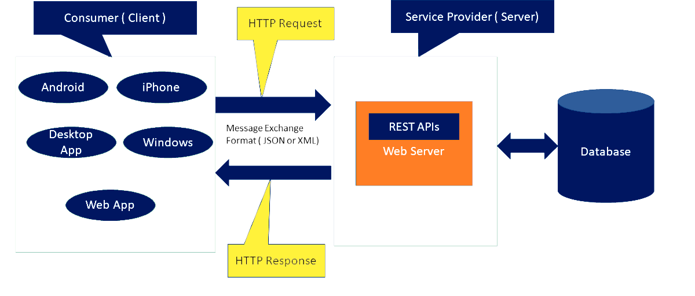
REST
Representational State Transfer is an architectural style for creating distributed applications and APIs based on the HTTP protocol.
The basic idea behind REST is that the client and server exchange
resources in the form of representations of the states of those resources.
REST Architectural:

Slide 17
REST
The principles of REST architecture:
Client-server architecture: clients and servers must be separated so that they can evolve independently of each other.
Stateless: each client request must contain all necessary information for the server to be able to process this request. The server should not store state between client requests.
Caching: clients must be able to cache server responses to reduce the load on the server and improve performance.
Uniform interface: clients and servers should use a uniform interface for sharing resources. This interface should be easy to understand and predictable.
Layered architecture: servers can be layered, such as load balancers, caching servers, etc., to improve performance and scalability.

Slide 18
REST API
Representational State Transfer Application Programming Interface is an architectural style used to create web services that exchange data with clients over HTTP.
The REST API is used to exchange data between client and server applications using the HTTP protocol.
The REST API relies on the use of standard HTTP methods such as GET, POST, PUT and DELETE to perform operations on resources.
In the REST API, each resource is represented by a unique URL, and client applications can send requests to that address to access the resource.
The REST API uses data formats, such as JSON or XML, to represent resources and transfer data between the client and the server.
The REST API is used in many applications, such as social networks, messengers, online stores, and others, and allows you to create flexible and scalable web services that can exchange data with client applications on different platforms and devices.

Slide 19
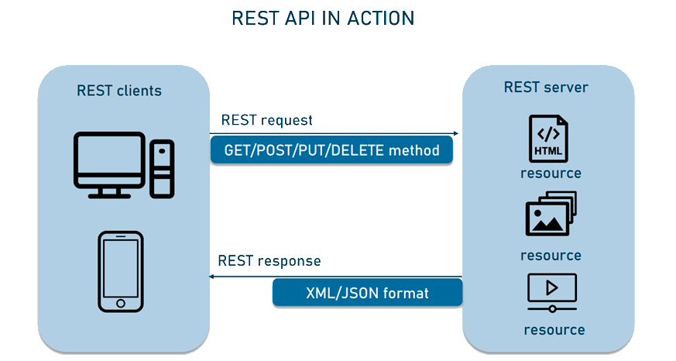
REST API

Slide 20

RESTful API
RESTful API is an API that fully conforms to the principles of REST architecture. It means that RESTful API uses all basic REST principles such as client-server architecture, no state, caching, uniform interface, etc. The RESTful API must also use standard HTTP methods (GET, POST, PUT, DELETE) and URIs to access resources.
The REST API may not be entirely consistent with these principles, and so it may not be fully RESTful. The main difference between the REST API and the RESTful API is that the RESTful API is fully consistent with the principles of the REST architecture, while the REST API can use some of these principles, but does not have to use all of them.

Slide 21
HTTP PROTOCOLS EXAMPLE
http::request<http::string_body> req{verb, target, version}; - creating a request with a specific verb, target, and http protocol version
req.set() - is used to set the HTTP header value. It has three overloads:
req.set(http::field::host, _host); - The first overload takes the header name as string_view and the header value as string_view. This method replaces any existing header value with the new value specified in value.
req.set(http::field::user_agent, BOOST_BEAST_VERSION_STRING); - The second overload takes a field object, which represents an HTTP header. This method replaces any existing header value with the new value specified in the field object.
req.set(http::field::content_type, "application/x-www-form-urlencoded"); - The third overload takes a field object, which represents the HTTP header, and the header value specified as string_view. This method replaces any existing header value with the new value specified in value.
https://github.com/memorisecodead/BeastExample/blob/main/Examples/HTTPRequests/HTTPExample.hpp

Slide 22
HTTP PROTOCOLS EXAMPLE
http::response is an HTTP response class that is used to send content to the client. It can be parameterized with different response body types, such as http::string_body, http::file_body, http::buffer_body and others.
The http::response class has many methods to set response properties, such as HTTP version, response status, headers, response body and others. For example, to set response status and "Content-Type" header, you can use the following code:
http::response<http::string_body> res;
res.version(version);
res.result(status);
res.set(http::field::server, BOOST_BEAST_VERSION_STRING);
res.set(http::field::content_type, "text/html");
https://github.com/memorisecodead/BeastExample/blob/main/Examples/HTTPRequests/HTTPExample.hpp

Slide 23
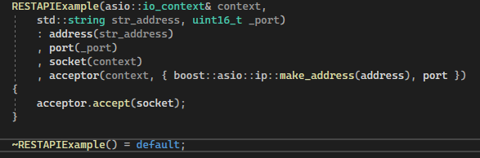
REST API EXAMPLE
Here's an example of using Boost.Beast to create a simple REST API:
Constructor & destructor:
Creating an io_context object, which is used to manage asynchronous I/O operations. Then an acceptor object is created that listens on a given port. For each incoming connection a socket object is created and a connection is accepted using the accept() method.
https://github.com/memorisecodead/BeastExample/blob/main/Examples/RESTAPI/RESTAPIExample.hpp

Slide 24
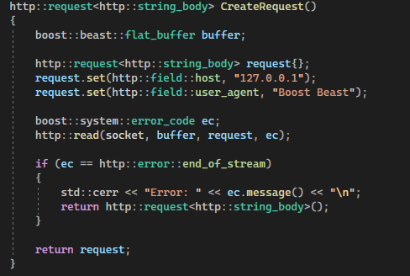
REST API EXAMPLE
The method of creating a request:
Uses boost::beast::flat_buffer to read request from socket and http::request object to parse request. After reading, using the http::read(socket, buffer, request, ec) method, we read the server's response after sending the request. This method reads the contents of the HTTP response and returns it as a string or object. If the request is successfully parsed, a response is created using the http::response object.
https://github.com/memorisecodead/BeastExample/blob/main/Examples/RESTAPI/RESTAPIExample.hpp

Slide 25
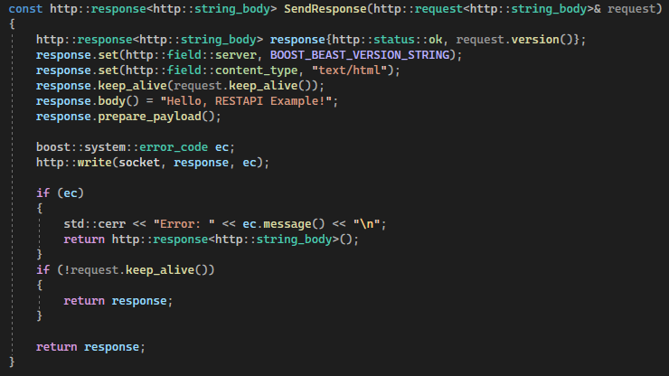
REST API EXAMPLE
The method of sending a response to a request:
If the request is successfully parsed, a response is created using the http::response object. In this example, we set the response status to http::status::ok, the Server header to the current version of Boost.Beast, and the content type to text/html. We also set the keep-alive flag for the response to maintain a persistent connection. We then set the body of the response to "Hello, RESTAPI Example!" and prepare it for sending using the prepare_payload() method. We send the response to the client using the http::write() method.
If the request was not marked as keep-alive, we exit and terminate the server.
https://github.com/memorisecodead/BeastExample/blob/main/Examples/RESTAPI/RESTAPIExample.hpp

Slide 26
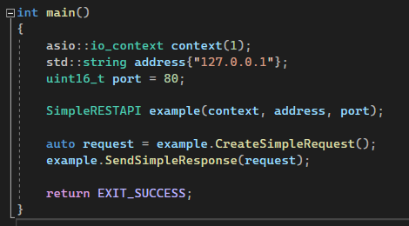
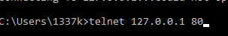
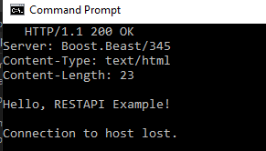
REST API EXAMPLE
Main foo:
Client role: telnet
Once started, the server will listen on port 80 and respond to HTTP requests with a status of 200 OK and the response body "Hello, RESTAPI Example!".
https://github.com/memorisecodead/BeastExample/blob/main/Examples/RESTAPI/RESTAPIExample.hpp

Slide 27
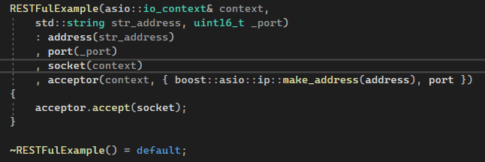
RESTful API EXAMPLE
Here's an example of using Boost.Beast to create a simple RESTFul API:
Constructor & destructor:
Creating an io_context object, which is used to manage asynchronous I/O operations. Then an acceptor object is created that listens on a given port. For each incoming connection a socket object is created and a connection is accepted using the accept() method.
https://github.com/memorisecodead/BeastExample/blob/main/Examples/RESTFulAPI/RESTFulAPIExample.hpp

Slide 28
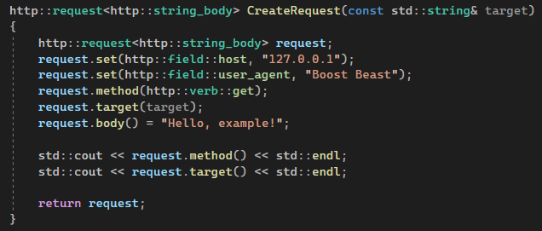
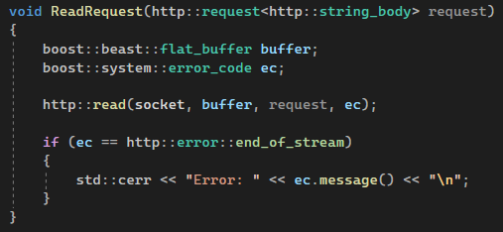
RESTful API EXAMPLE
The method of creating a request:
Creating a http::request<http::string_body> object which used from setup request object. Then setting a host, user_agent, method, body for forming request.
The method of reading a request:
Uses boost::beast::flat_buffer to read request from socket and http::request object to parse request. After reading, using the http::read(socket, buffer, request, ec) method, we read the server's response after sending the request. This method reads the contents of the HTTP response and returns it as a string or object. If the request is successfully parsed, a response is created using the http::response object.
https://github.com/memorisecodead/BeastExample/blob/main/Examples/RESTFulAPI/RESTFulAPIExample.hpp

Slide 29
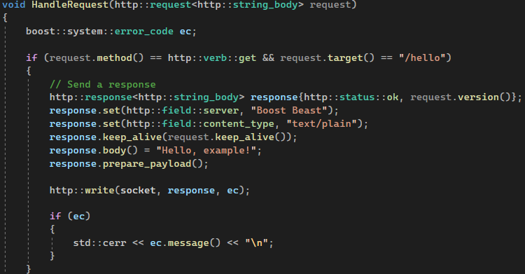
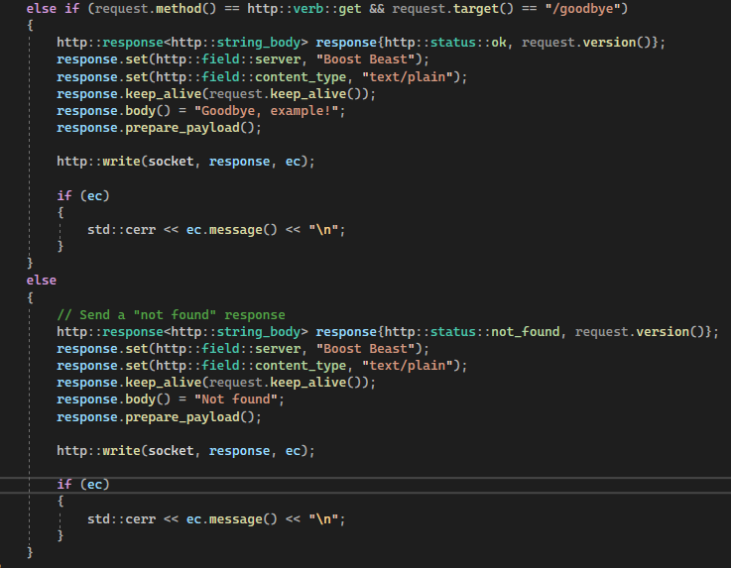
RESTful API EXAMPLE
The method of handling a request:
If the request is successfully parsed, a response is created using the http::response object. In this example, we set the response status to http::status::ok, the Server header to the current version of Boost.Beast, and the content type to text/plain. We also set the keep-alive flag for the response to maintain a persistent connection. We then set the body of the response to "Hello, RESTAPI Example!" and prepare it for sending using the prepare_payload() method. We send the response to the client using the http::write() method.
https://github.com/memorisecodead/BeastExample/blob/main/Examples/RESTFulAPI/RESTFulAPIExample.hpp

Slide 30
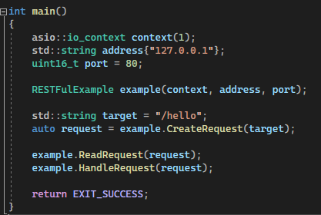
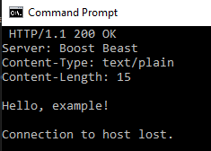
RESTful API EXAMPLE
Main foo:
Client role: telnet
This example creates a server that listens for incoming connections on port 80. When the server receives GET requests at the "/hello" or "/goodbye" URLs, it sends a response with an appropriate message. If the server receives requests for another URL, it sends a response with a 404 "Not found" code. This example demonstrates the basic principles of the RESTful API, such as using HTTP methods and URLs for requests and responses.
https://github.com/memorisecodead/BeastExample/blob/main/Examples/RESTFulAPI/RESTFulAPIExample.hpp

Slide 31

CONCLUSION

Slide 32



REFERENCES

